Slide 1
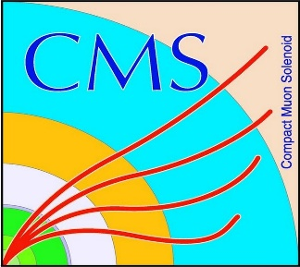

HEP Weekly Report
George Bakas
NTUA

Slide 2
Progress Report
DCS
fwInstallationUtils
Ready to deploy tool
Writing documentation
CmsFwInstallUtils
Found a way to show the user where the inconsistencies are in case the tool doesn’t find the inconsistency correctly
Analysis
QCD closure tests
For analysis with our new tagger vs deepAK8
Angular distributions
TT contamination
ArdEnvino
New screen.
This screen is mounted on top of the Arduino
Managed to make it work. Needed soldering
Problem is that it doesn’t fit on to breadboard to check which pins are actually used

